Slide 1
MORPHFUN
Group 04
Armando Boemio Lorenzo Brugioni Gabriele Maucione Paolo Sani
Exam Presentation 26/06/2022 A.Y. 2021/2022
PROJECT PRESENTATION
BOOST YOUR CREATIVITY

Slide 2
Playing an instrument is a lot of fun, but what if you could have
MORPHFUN?

Slide 3
MORPHFUN IDEA
MorphFun is a Timbre Transfer application, that relies on a
Pose Estimation approach to let the user choose the instrument
Timbre Transfer: it changes the timbre of an input sound
→ enormous boost in
CREATIVITY
Pose Estimation: thought to make the application
an immersive and funny experience

Slide 4
RESOURCES
HOW IT WORKS
The user live records an audio: the system loops it until another recording is enabled or the application is closed
While the loop is on, the system continuously checks – by the use of the input camera or webcam – for the pose provided by the user
Each pose is assigned to an instrument: if the system recognizes the pose of the violin, the output looping audio is morphed as it was played by a violin

Slide 5
HOW IT WORKS - USER INTERACTION
Recording
POSing
LISTENING
The user provides the input audio
The user provides the pose of the selected instrument
The morphed audio is reproduced, the user can record again

Slide 6
HOW IT WORKS
MORPHUN
TIMBRE TRANSFER
GESTURE RECOGNITION
There are two main modules
The audio recorded by the user is morphed as it was played by one of the chosable instruments
The user selects the desired output instrument by providing the system with a pose

Slide 7
TIMBRE TRANSFER
The main operating idea of MorphFun is the Timbre Transfer

Slide 8
TIMBRE TRANSFER
Reference: Tone Transfer
The system is inspired by Tone Transfer, a webapp developed by Magenta
Tool: DDSP
The system expoilts the DDSP library, developed by Magenta
Each instrument morphing is obtained using pre-trained tunable models available with DDSP
Environment: local
The system works in a fully local fashion

Slide 9
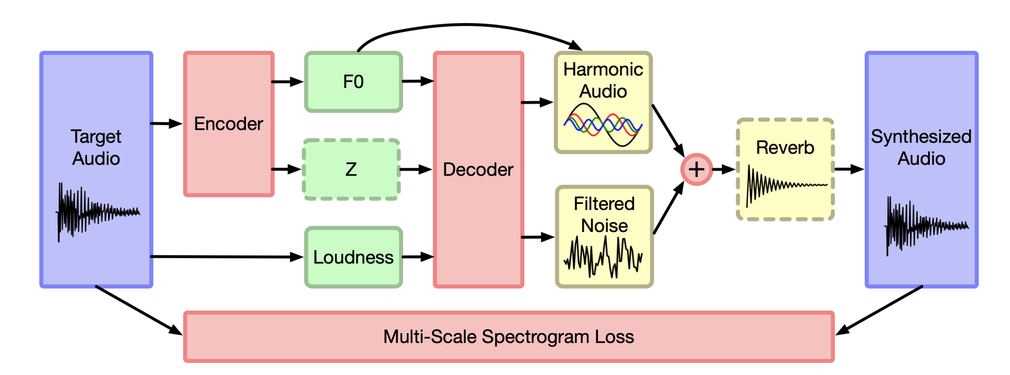
TONE TRANSFER by Magenta
Red components are part of the neural network architecture,
green components are the latent representation, and yellow components are deterministic synthesizers and effects.

Slide 10
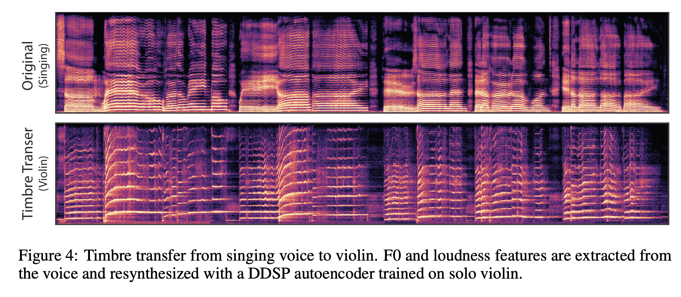
TONE TRANSFER by Magenta

Slide 11

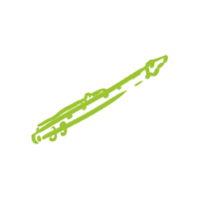
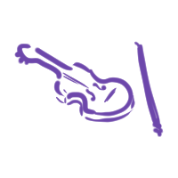

FEATURED INSTRUMENTS
Flute
Trumpet
Violin
Saxophone

Slide 12
GESTURE RECOGNITION
The video input that let the user choose

Slide 13
GESTURE RECOGNITION – POSE ESTIMATION
The selection that the user acts among the different output instruments for the morphing is based on a Gesture Recognition procedure
Challenges of the task
The user can be in different places, or even have different shapes (body, clothes, ecc)
Solution
Pose Estimation algorithm

Slide 14
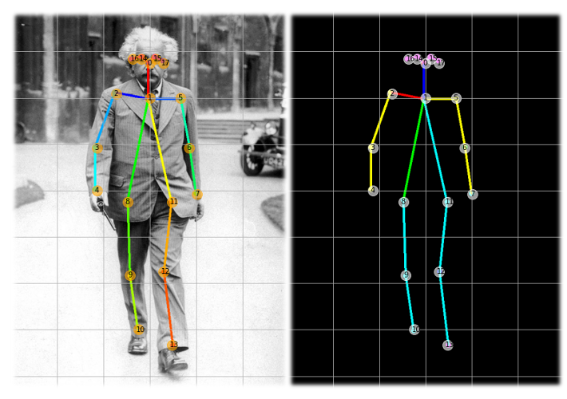
POSE ESTIMATION
The Pose Estimation algorithm recognizes the body of the user and its position using an array of key-points
Estimation and Classification (Regression + Multi-class Classification)
Light-weight model need
Model trained on custom dataset

Slide 15
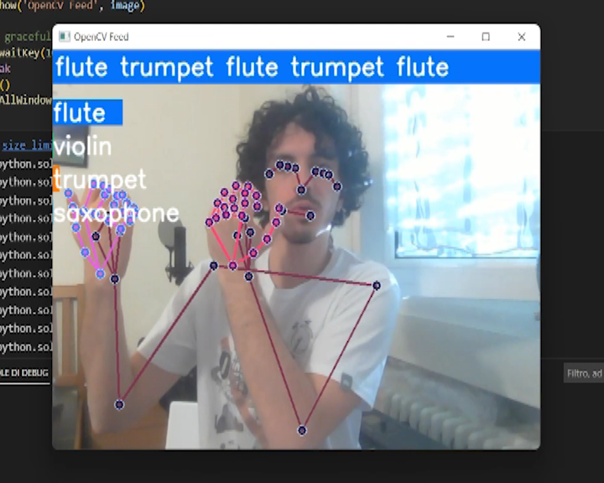
POSE ESTIMATION
Neural Network training
Keypoints on the human body have been collected from Mediapipe Holistic
The deep neural network has been trained with LSTM layers for sequences
Real-time sign language detection is performed using OpenCV

Slide 16
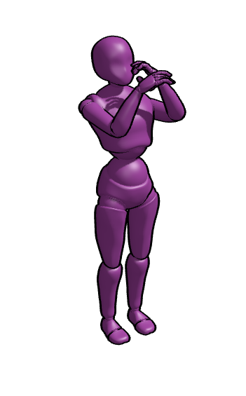
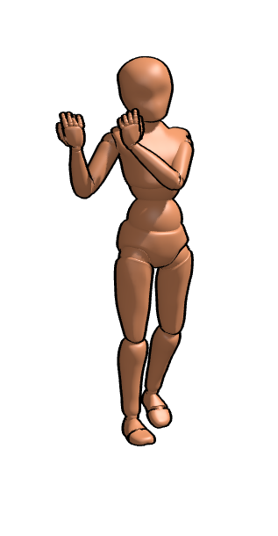


FEATURED GESTURES
Each output instrument is associated with a pose that the user can do:
Trumpet
Flute
Violin
Saxophone

Slide 17
GRAPHIC USER INTERFACE
How the GUI has been made

Slide 18
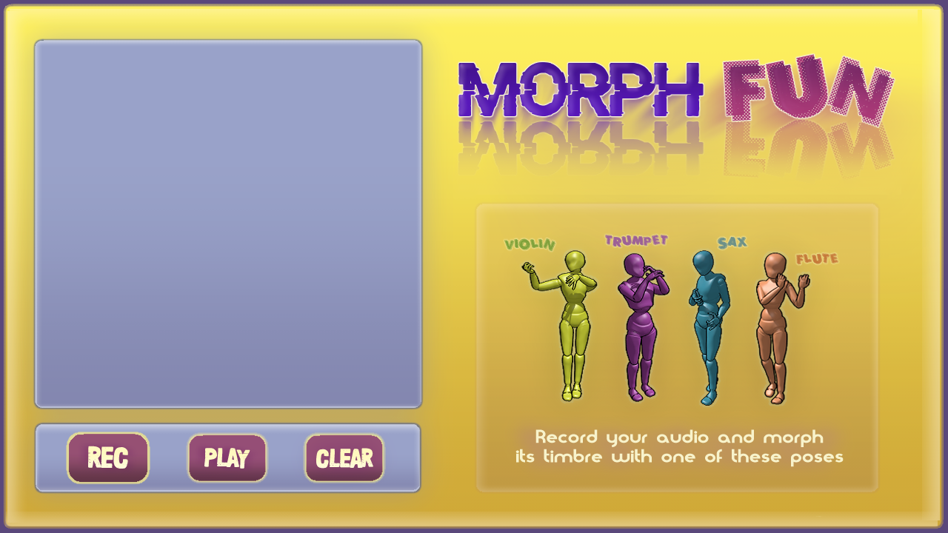
GRAPHIC USER INTERFACE

Slide 19
GUI
Designed with
PyQt5
Writing on two queues
The webcam writes on the data queue
The buttons «Rec», «Play»/»Stop» and «Clear» write on the command queue
Very flexible, with various UI components
Thread safe

Slide 20
CODE ARCHITECTURE
How the single modules communicate

Slide 21
MODULES
MAIN
WHOLESALER
RETAILERS
RETAILERS
CONSUMER
CONSUMER
CONSUMER

Slide 22
STRATEGY
Jupiter is the biggest planet in the Solar System
02
Earth is the planet where we live on
01
04
Pluto is now a dwarf planet
Despite being red, Mars is actually a cold place
03

Slide 23
It’s demo time!

Slide 24
Possible Improvements

Slide 25
Repository
The whole code is available at this link:

Slide 26
THANKS!

